Slide 1
Biobank & Biospecimen
Management System

Slide 2
AGENDA
What We'll Cover
01
02
03
Problem & Scope
Conceptual Design
Relational Schema
Why a biobank needs a database, and what it must manage
Entities, attributes, and the ER diagram
Keys, constraints, and normalization to 3NF
04
05
06
Implementation
Live Demo & Testing
Wrap-up
DDL, test data, queries, views & triggers
Business rules enforced in action
Limitations, and next steps (bonus UI)
Biobank & Biospecimen Management System
2

Slide 3
PROBLEM STATEMENT
Why a Biobank Needs a Database
A biobank collects, stores, and distributes human biospecimens for research. Without a structured system, labs lose track of:
SCOPE
Whether a donor's consent is still active
Where every physical aliquot is stored, and at what temperature
How much of a sample has already been used for testing
Which researcher requested which test, and its status
Donor enrollment & informed consent
Sample collection events
Aliquoting & cold-chain storage tracking
Researcher test requests
Sample usage against active consent
Out of scope: billing, shipping logistics, and patient clinical records.
Biobank & Biospecimen Management System
3

Slide 4
BUSINESS RULES
Key Rules the Database Must Enforce
A sample cannot be used
Volumes must stay positive
if the donor's consent has been withdrawn.
no zero or negative aliquot / sample volumes.
Consent must expire after signing
Aliquot status updates itself
expiry_date always postdates date_signed.
flips to InUse / Depleted as usage accumulates.
Biobank & Biospecimen Management System
4

Slide 5
CONCEPTUAL DESIGN
Ten Core Entities
Donor
Researcher
ConsentForm
CollectionEvent
SampleType
Sample
StorageLocation
Aliquot
TestRequest
SampleUsage
Green = associative table resolving the Aliquot ↔ TestRequest many-to-many relationship (records exactly which aliquot volume was consumed by which test request).
Biobank & Biospecimen Management System
5

Slide 6
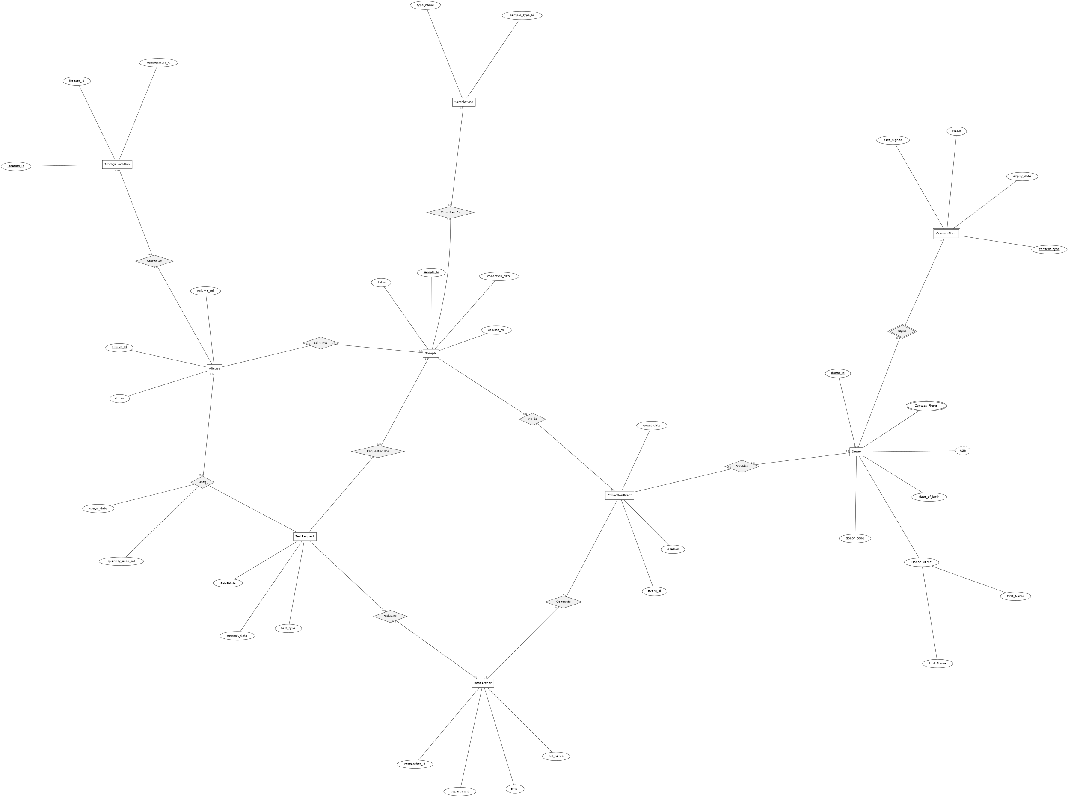
ER DIAGRAM
Entities, Relationships & Attributes (Chen Notation)
6

Slide 7
LOGICAL DESIGN
From ER Model to Relational Schema
TABLE
PRIMARY KEY
FOREIGN KEYS
Sample
sample_id (PK)
donor_id, sample_type_id, event_id (FK)
Aliquot
aliquot_id (PK)
sample_id, location_id (FK)
TestRequest
request_id (PK)
sample_id, researcher_id (FK)
SampleUsage
usage_id (PK)
aliquot_id, request_id (FK) — resolves M:N
Every 1:N ER relationship becomes a foreign key on the “many” side. The Aliquot ↔ TestRequest M:N relationship becomes its own table (SampleUsage) carrying both foreign keys plus its own attributes.
Biobank & Biospecimen Management System
7

Slide 8
NORMALIZATION
Why the Schema Is in 3NF
1NF
2NF
3NF
Atomic values
No partial dependency
No transitive dependency
No repeating groups — e.g. a Sample never stores a list of aliquot IDs in one field; Aliquot is its own table.
Every table uses a single-column surrogate key, so no attribute can depend on “part” of the key.
Storage requirements depend only on SampleType, not on Sample — so SampleType is factored into its own lookup table.
Biobank & Biospecimen Management System
8

Slide 9
IMPLEMENTATION
create_tables.sql — Constraints in Practice
CREATE TABLE ConsentForm (
consent_id SERIAL PRIMARY KEY,
donor_id INT NOT NULL REFERENCES Donor(donor_id) ON DELETE CASCADE,
consent_type VARCHAR(50) NOT NULL CHECK (consent_type IN
('Research','Commercial','Broad','Restricted')),
date_signed DATE NOT NULL,
expiry_date DATE,
status VARCHAR(20) NOT NULL DEFAULT 'Active'
CHECK (status IN ('Active','Withdrawn','Expired')),
CONSTRAINT chk_consent_dates
CHECK (expiry_date IS NULL OR expiry_date > date_signed)
);
Referential integrity (FK + CASCADE), domain constraints (CHECK), and cross-column rules all live in the schema — not in application code.
Biobank & Biospecimen Management System
9

Slide 10
QUERIES.SQL
SQL in Action
1
Join
2
Aggregation
List every aliquot with its sample, donor, and storage location in one readable row.
Count samples per SampleType; find researchers with more than one request (HAVING).
3
Correlated Subquery
4
DML
Aliquots whose recorded usage already exceeds 50% of their original volume.
INSERT a new donor + consent, UPDATE consent status, DELETE unused rejected requests.
Biobank & Biospecimen Management System
10

Slide 11
VIEWS.SQL
Two Views for Everyday Use
VIEW
VIEW
vw_sample_inventory
vw_researcher_activity
One row per sample with donor, type, and live aliquot count + remaining volume — lab staff check stock without writing joins.
Per-researcher request counts, completion rate, and total volume of material consumed — used for management reporting.
Biobank & Biospecimen Management System
11

Slide 12
TRIGGERS_PROCEDURES.SQL
The Database Detects Usage Automatically
Nobody updates an aliquot's status by hand. Every INSERT into SampleUsage fires two triggers:
1
trg_check_consent_before_usage
BEFORE INSERT — blocks the insert if the donor's consent is not Active. Raises an exception, transaction rolls back.
2
trg_update_aliquot_status
AFTER INSERT — sums all usage against the aliquot; flips its status to InUse or, once fully consumed, Depleted.
Stored function — sp_record_sample_usage(aliquot_id, request_id, quantity, purpose)
Wraps the INSERT and returns the aliquot's remaining volume in one call — a single, safe entry point for the lab workflow instead of a raw multi-step INSERT.
Biobank & Biospecimen Management System
12

Slide 13
TESTING
Proving the Rules Actually Hold
TEST CASE
RESULT
Withdraw a donor's consent, then INSERT a SampleUsage for their aliquot
✓ Trigger raises an exception — insert rejected
INSERT an Aliquot with volume_ml = -5
✓ CHECK constraint violation — insert rejected
Fully consume an aliquot via two SampleUsage rows
✓ Aliquot status auto-flips to ‘Depleted’
Set ConsentForm.expiry_date earlier than date_signed
✓ chk_consent_dates violation — insert rejected
Biobank & Biospecimen Management System
13

Slide 14
WRAP-UP
Limitations & Next Steps
LIMITATIONS
NEXT STEP — BONUS UI
No audit trail of who changed a record and when
Storage capacity per freezer is not modeled or enforced
No automated alerting when consent nears expiry
A connected front-end (Python/Flask or Node) for live CRUD on samples & requests
Search and filter over vw_sample_inventory
Form-based consent withdrawal calling sp_record_sample_usage guardrails
Biobank & Biospecimen Management System
14

Slide 15
Thank You

